Slide 1
Inferring stream food web structure
Justin Pomeranz, Jon Harding, Ross Thompson

Slide 2
Introduction
Food webs offer a simple, powerful way of incorporating complex aspects of diversity, community structure and ecosystem function.
However, their construction is logistically constraining, and it is difficult to do over a large spatial, or temporal scale, or across environmental gradients.
Therefore, there is a need for tools to be developed to make it possible to infer food web structure.

Slide 3
Objectives
Compare the use of two recently proposed methods for inferring food web structure.
Aim is to offer a method for the inference of fresh water stream food webs.

Slide 4
Data
Data used was 21 food webs published in Thompson and Townsend 1999, 2004.
17 of these food webs had species averaged biomass estimates, used in trait-matching method (see below).
Additional feeding interactions from published literature (Table, next slide)
Thompson, R.M. & Townsend, C.R. (1999). The Effect of Seasonal Variation on the Community Structure and Food-Web Attributes of Two Streams : Implications for Food-Web Science. Oikos, 87, 75–88
Thompson, R.M. & Townsend, C.R. (2004). Land ‐ use influences on New Zealand stream communities : Effects on species composition , functional organisation , and food ‐ web structure. New Zeal. J. Mar. Freshw. Res., 38, 595–608

Slide 5
Sources for other published feeding interactions
Hogsden and Harding 2012
Hogsden and Harding 2013
Rose Gregersen MSc Thesis
Jellyman and Harding 2016
Bonnett ML, Lambert PW. 2002. Diet of giant kokopu, Galaxias argenteus. New Zealand Journal of Marine and Freshwater Research 36(2):361-369.
Collier KJ, Wright‐Stow AE, Smith BJ. 2004. Trophic basis of production for a mayfly in a North Island, New Zealand, forest stream: contributions of benthic versus hyporheic habitats and implications for restoration. New Zealand Journal of Marine and Freshwater Research 38(2):301-314.
Cowley D. 1978. Studies on the larvae of New Zealand Trichoptera. New Zealand journal of zoology 5(4):639-750.
Crosby T. 1975. Food of the New Zealand trichopterans Hydrobiosis parumbripennis McFarlane and Hydropsyche colonica McLachlan. Freshwater biology 5(2):105-114.
Devonport B, Winterbourn M. 1976. The feeding relationships of two invertebrate predators in a New Zealand river. Freshwater biology 6(2):167-176.
Hollows JW, Townsend CR, Collier KJ. 2002. Diet of the crayfish Paranephrops zealandicus in bush and pasture streams: insights from stable isotopes and stomach analysis. New Zealand Journal of Marine and Freshwater Research 36(1):129-142.
Jellyman D. 1996. Diet of longfinned eels, Anguilla dieffenbachii, in Lake Rotoiti, Nelson Lakes, New Zealand. New Zealand Journal of Marine and Freshwater Research 30(3):365-369.
Jellyman DJ. 1989. Diet of two species of freshwater eel (Anguilla spp.) in Lake Pounui, New Zealand. New Zealand journal of marine and freshwater research 23(1):1-10.
McDowall R, Main M, West D, Lyon G. 1996. Terrestrial and benthic foods in the diet of the shortjawed kokopu, Galaxias postvectis Clarke (Teleostei: Galaxiidae). New Zealand journal of marine and freshwater research 30(2):257-269.
Rounick J, Hicks BJ. 1985. The stable carbon isotope ratios of fish and their invertebrate prey in four New Zealand rivers. Freshwater biology 15(2):207-214.
Winterbourn M, Cowie B, Rounick J. 1984. Food resources and ingestion patterns of insects along a west coast, South Island, river system∗. New Zealand journal of marine and freshwater research 18(3):379-388
Winterbourn MJ. 1996. Life history, production and food of Aphrophila neozelandica (Diptera: TipuIidae) in a New Zealand stream. Aquatic Insects 18(1):45-53.

Slide 6
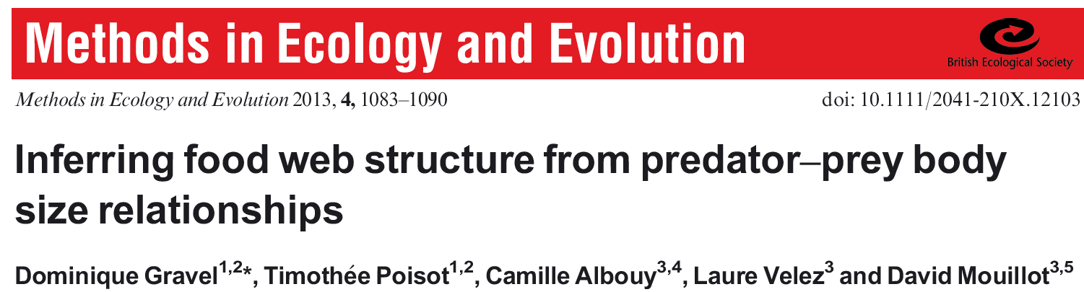
Methods: Tool 1 – mechanistic trait matching
Gravel, D., Poisot, T., Albouy, C., Velez, L. & Mouillot, D. (2013). Inferring food web structure from predator – prey body size relationships. Methods Ecol. Evol., 4, 1083–1090

Slide 7
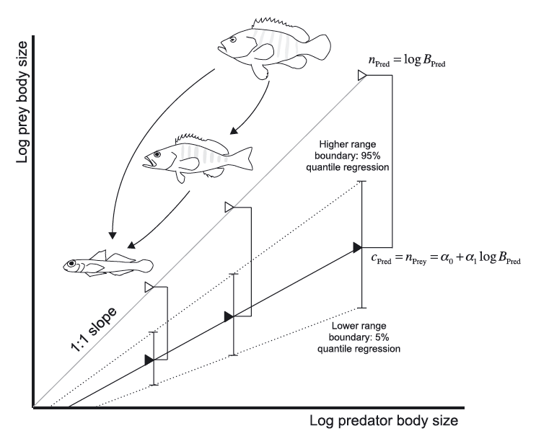
Parameterize Niche Model
Use published feeding interactions with associated body sizes.
Parameterize niche model (sensu Wiliams and Martinez 2000), apply this to novel set of species averaged body sizes of a community.
Infer feeding interactions based on body sizes (ataxonomic).
Currently only applicable to predatory interactions, as herbivore body mass / resource mass relationship less robust
Fig from Gravel et al. 2013 illustrating niche model. For a given consumers body mass (top line, white triangles), there is a range of prey body sizes it can feed on represented by a centroid (lower bold line, black triangles), and an upper and lower limit (dashed lines).

Slide 8
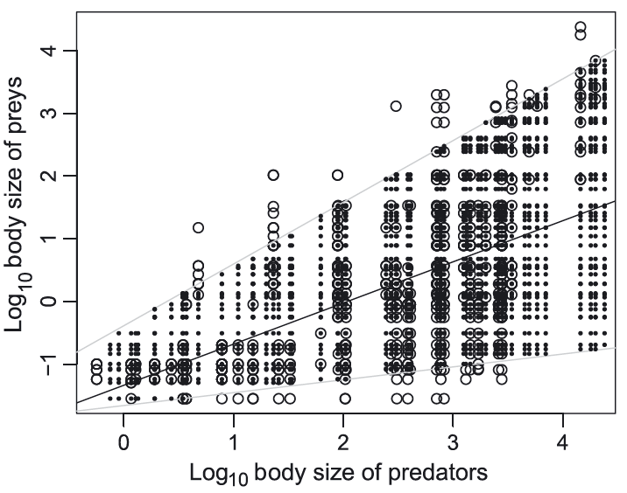
Quantile regression of known feeding interactions →
inference of potential feeding interactions
Fig 2 from Gravel et al. 2013 illustrating how quantile regression of known feeding interactions (open circles) can be used to infer feeding interactions (closed circles).

Slide 9
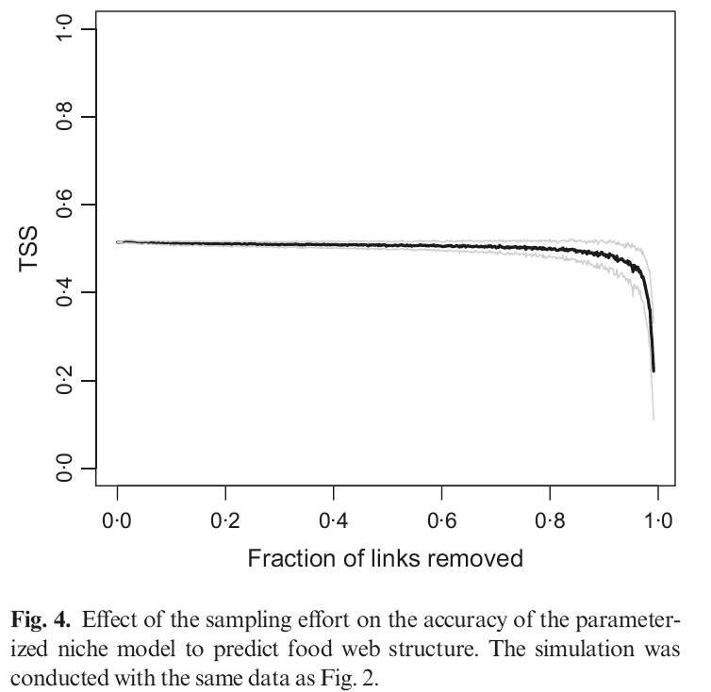
Method is robust to sampling effort
Fig from Gravel et al. 2013 showing methods robustness to “missing” feeding links

Slide 10
Potential pros and cons of trait-matching method
Pros
Allow for site specific feeding interactions i.e. distributions of body sizes can be site dependent
Allow for the inference of feeding interactions in novel species co-occurences. i.e. species invasions, or species that have not been documented together before
Robust to “missing” links
Cons
Requires additional data collection e.g. body sizes / biomass
Many studies, surveys, biomonitoring programs, do not include this already
Requires additional model parameterization

Slide 11
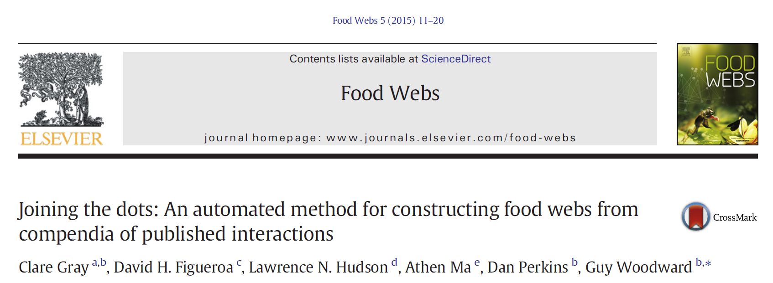
Tool 2: WebBuilder

Slide 12
WebBuilder
Relies on registry of published feeding interactions.
Assumes that if species i can eat species j (i.e. has been documented previousy), than whenever i and j co-occur, there will be a feeding interaction.
Can modify based on taxonomic information at different levels e.g. exact species pairs (Coloburiscus humeralis → Salmo trutta), genera (Coloburiscus → Salmo), family, order.
Can also modify consumer and resource separately e.g. Salmo trutta eats ALL ephemeroptera.

Slide 13
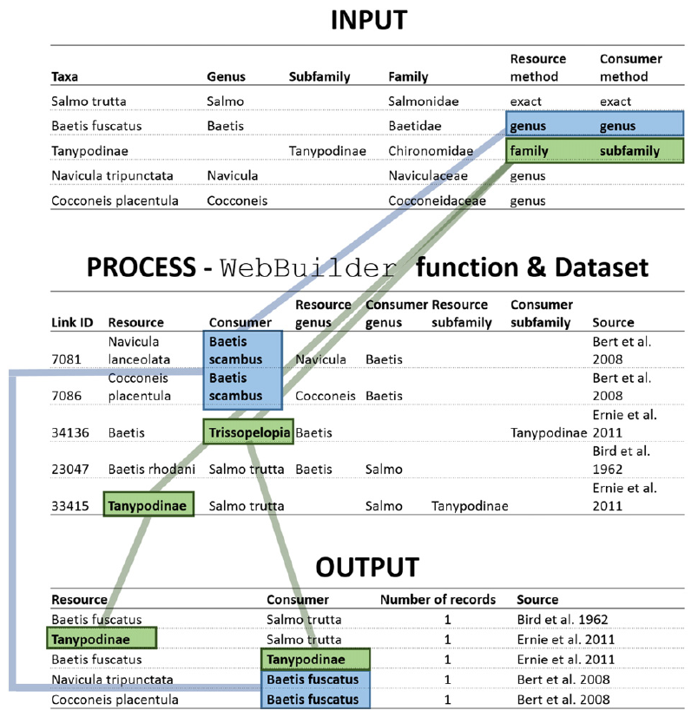
Fig from Gray et al. 2015 illustrating WebBuilder process.

Slide 14
Potential pros and cons of WebBuilder function
Pros
Easily constructed, once registry is made, only data needed is a list of species.
Can predict novel feeding interactions based on phylogenic relationships. E.g. many genera within family have similar prey preferences.
Can infer non-predatory feeding interactions e.g. herbivory, detritovores
Cons
Does not allow for feeding interactions to vary between sites.
Insensitive to changes in food web structure across gradients unless concomitant large change in species turnover.
Does not account for ontogenetic diet shifts, unless previous studies differentiated life stage / size class

Slide 15
Methods – inferring links
Links were inferred using both methods. In both methods, the data for a web being inferred was withheld from the model parameterization / registry construction, to avoid circularities.
e.g. 17 total webs with biomass information. So when inferring links for web_{i} only the data from 16 webs were used to infer that web (all webs - web_{i} ).
Since only 17 webs had biomass information, only those 17 webs were inferred using both methods.
Additionally, not all taxa in 17 webs had biomass estimates, so webs inferred using the WebBuilder method had their taxa “trimmed” to match in order to make comparisons fair.
Empirical webs were also trimmed to match in order to calculate TSS (see below) appropriately.

Slide 16
Methods – Pruning “forbidden links”
Trait-matching infers feeding interactions based solely on body size. However, many large invertebrates are non-predatory (e.g. Coloburiscus). Therefore it is necessary to prune “forbidden links”. This was accomplished by conservatively identifying invertebrates that are non-predatory, largely based on morphology. i.e. scrapers and filter feeders such as Austrosimulium, do not have the mouthparts to allow them to be predatory. However, filter feeding Aoteapsyche could potentially eat small animals caught in its net, so its links were not pruned.
Note that this step is not necessary for the WebBuilder, as only observed links are used. E.g. if scrapers really cannot eat animals they will not appear in registry of published links.
Morales-castilla et al. 2015 http://dx.doi.org/10.1016/j.tree.2015.03.014

Slide 17
Methods – Neutral model correction
The neutral model states that the probability of a feeding interaction occurring between two species is directly proportional to their relative abundances (essentially assumes no prey are preferred or avoided). i.e. two common species are very likely to meet and interact, whereas two rare species are unlikely to meet. The probability is often calculated by multiplying two species relative abundances together (see table). This correction can be performed on both methods.
Relative abundances
Species i | Species j | P (link) ∝ x
0.30 | 0.50 | 0.15
0.10 | 0.40 | 0.04
0.01 | 0.01 | 0.001
Poisot et al. 2014 doi: 10.1111/oik.01719

Slide 18
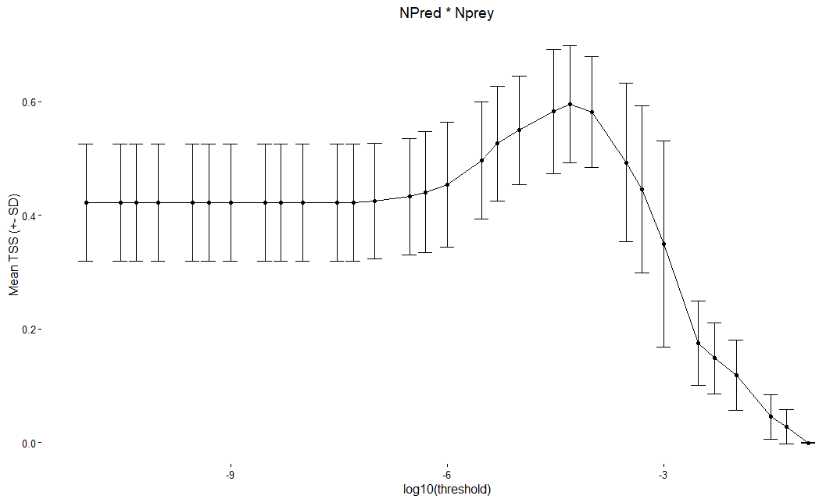
Methods – Neutral model correction cont’d
Since this relationship is proportional, and not directly equal to the multiplied relative abundances, a threshold sensitivity response was performed.
Different thresholds were tested, where relative abundances below the threshold were assumed to not occur. i.e. species were too rare to interact.
Example to right, more details provided in results
TSS
Rare species pairs to left, increasingly abundant pairs to right

Slide 19

Comparison - TSS
The True Skill Statistic (TSS) was used to evaluate the performance of both methods.
The TSS is a general score for the models predictive capabilities, and ranges from 1 (perfect prediction) to -1 (inverse prediction).
a = true positive b = false positive c = false negative
d = true negative

Slide 20
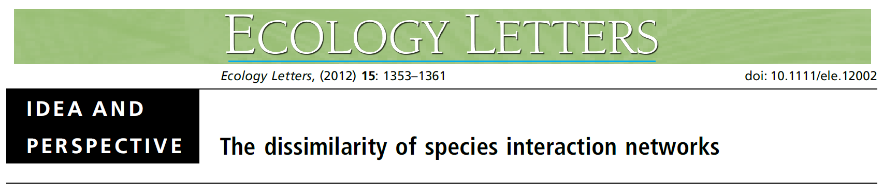
β species diversity β interaction diversity
Poisot et al. 2012
Poisot et al. 2012 provide measure of the dissimilarity of interactions based solely on species turnover β_{ST} , and the dissimilarity of shared species interacting differently β_{OS}
β’_{OS} is the dissimilarity of a local network with it’s counterpart in the metaweb.
β’_{OS} were calculated for all three web types (empirical, trait-matching inferred and WebBuilder function).
The WebBuilder function does not allow species interactions to vary by default, but I wanted to see if the values provided by the trait-matching method are realistic to empirical values.
Poisot, T., Canard, E., Mouillot, D., Mouquet, N. & Gravel, D. (2012). The dissimilarity of species interaction networks. Ecol. Lett., 15, 1353–1361

Slide 21
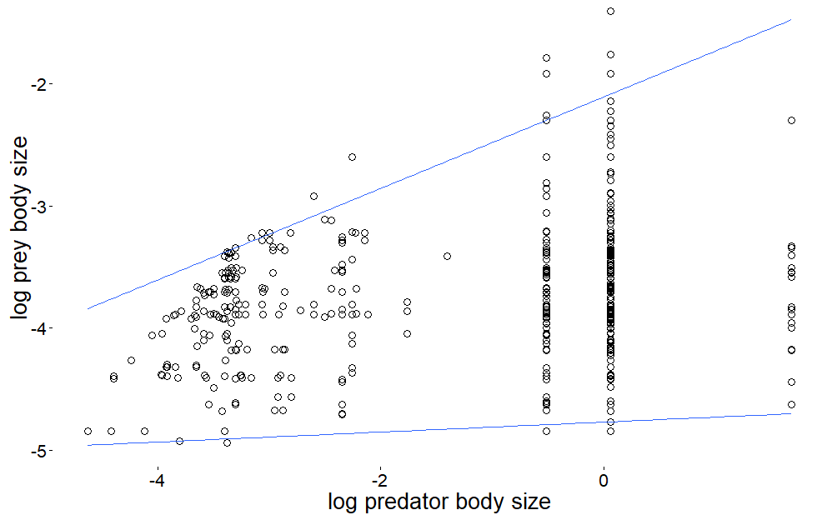
Trait- matching: Parameterizing niche model
Coefficient estimates based on these regressions are used to estimate the centroid and range of the diet breadth for a given body size.
Plot of quantile regression (0.97, 0.01) of feeding interactions between species averaged body mass from 16 food webs [-AkatoreB]

Slide 22
Fish in trait matching model
Fish lengths and abundances were not available in the data.
Downloaded fish data for the Taieri watershed from NZ fish data base.
Fish length data available were only minimum and maximum lengths.
Parameterized the model using 4 values: minimum-minimum, mean-minimum, mean-maximum, maximum-maximum.
NZ Fish database does not have abundance data, so performed sensitivity analysis using varying levels of relative fish abundance.

Slide 23
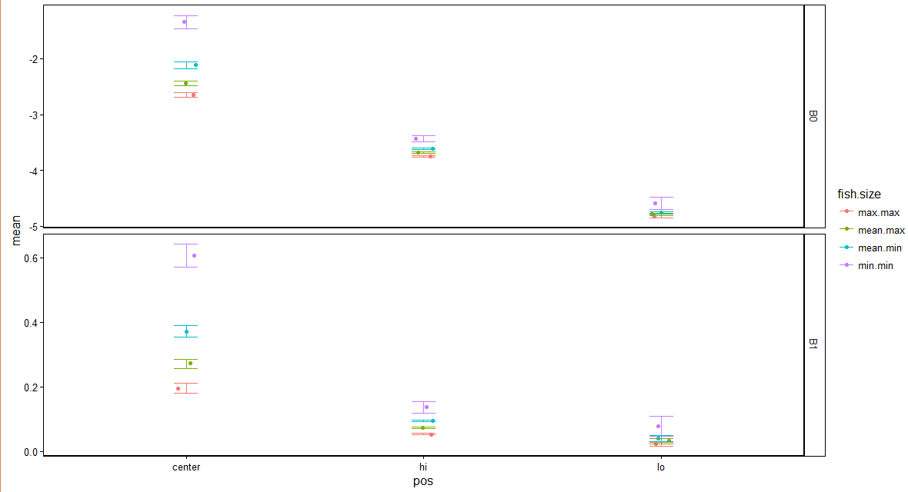
Gravel parameter coefficients ~ 4 fish size
Estimated parameter coefficients did vary based on fish sized used. However, TSS (next slide) did not vary significantly based on fish size used to parameterize model.
Parameters for trait-matching model, using 4 different sizes of fish. B0 (top panel) = intercept of the hi, center, and lo quantile regression. B1 (bottom panel) = slope of hi, center and lo quantile regression. Max.max = maximum max fish length, mean.max = mean maximum fish length, mean.min = mean minimum fish length, min.min = minimum min fish length

Slide 24
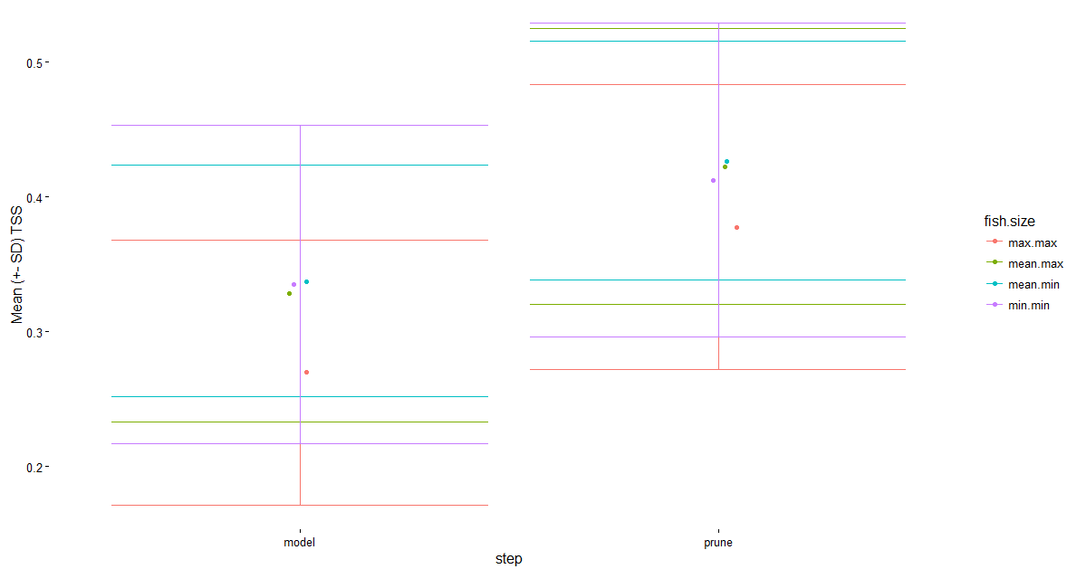
Gravel TSS ~ 4 fish size
Predictions did not vary significantly for 4 fish sizes used. However, variance aroun mean-min was lowest, so this was used in all further analyses
Supplemental. Mean TSS (+- SD), using 4 different sizes of fish. Model = initial inference. Prune = pruning “forbidden links” based on taxonomy.
Max.max = maximum max fish length, mean.max = mean maximum fish length, mean.min = mean minimum fish length, min.min = minimum min fish length

Slide 25
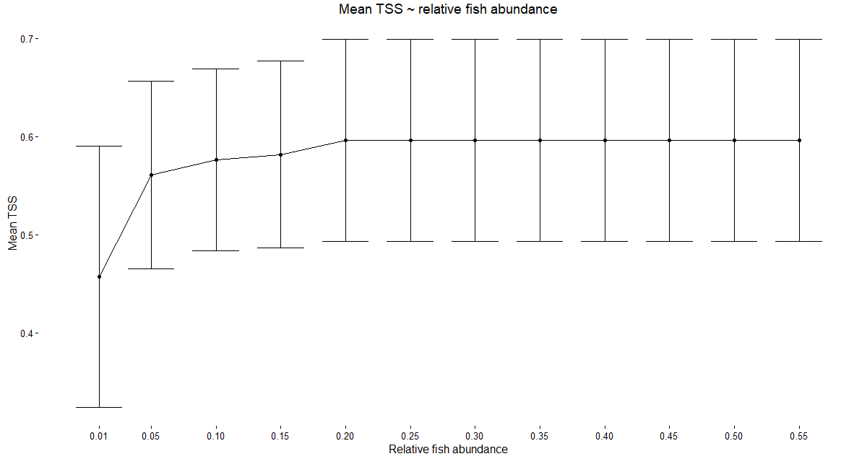
Gravel TSS ~ fish relative abundance values
TSS was dependent on relative fish abundance value. However, TSS was only sensitive to extremely low values for relative fish abundance (< 0.15). Used relative abundance value for fish of 0.20 for all further analyses

Slide 26
Trait matching, pruning “forbidden taxa”
The taxa listed at right were pruned from the predation matrices so that they were “forbidden” from consuming animals (e.g. their column values were set to 0).
These represent only taxa present in the Taieri food web data, and are not an exclusive list of “forbidden” taxa. If extending this to new sites with differing species composition, this list eould need to be expanded to include any other potential forbidden taxa at the new sites.
As previously mentioned, the pruning step was conservative, and based largely on morphology (e.g. mouthparts) and feeding behavior (e.g. filter feeding black flies).
A more liberal approach could be to look at all of the pairwise interactions in the food web registry (a la WebBuilder function) and restrict any species that never consumed animals of any kind.
But method as presented is a de novo construction of networks based solely on body size and putative feeding guilds.
Non-predatory taxa
Amphipoda
Atalophlebioides
Austroclima
Austrosimulium
Coloburiscus
Deleatidium
Nesameletus
Oxyethira
Potamopyrgus
Zephlebia

Slide 27
Trait-matching Neutral model consideration
Neutral model correction for trait-matching model did improve model predictions. Threshold of 5e-05 was used in all further analyses

Slide 28
Changing resolution of WebBuilder function
WebBuilder allows you to vary the level of taxonomic resolution. Following 2 slides are examples of inferred links from Dempsters and Little Kye Burn, based on Genus, Family, and Order level resolution.
On average, Genus level gives highest TSS (table below).
Notice that family resolution increases TSS for Dempsters, but decreases for Little Kye Burn compared with Genus resolution. Both of them are drastically reduced in the Order level resolution.
Resolution | Mean TSS
Genus | 0.6675
Family | 0.6281
Order | 0.2115

Slide 29
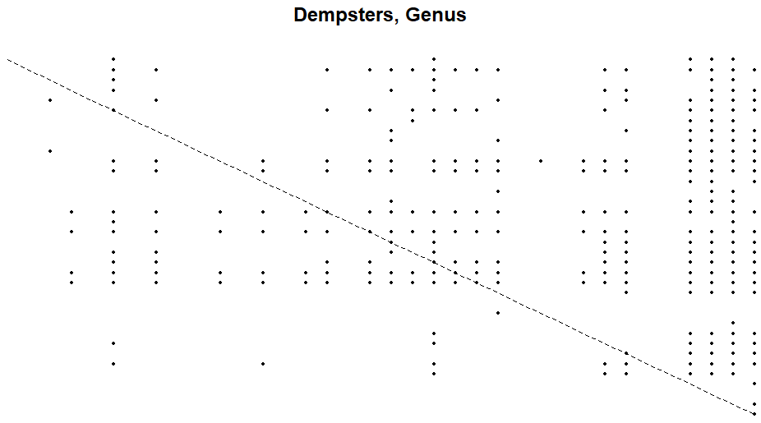
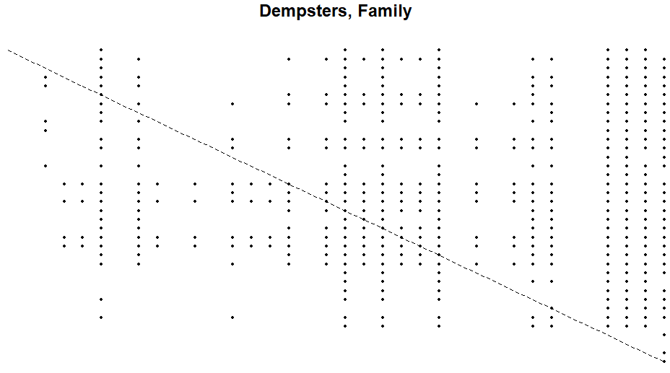
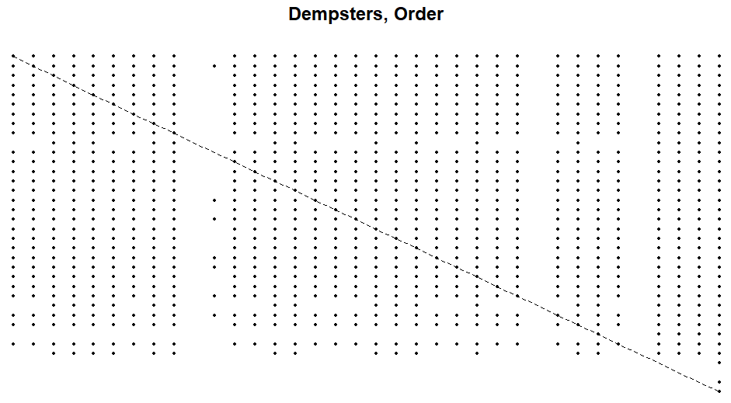
TSS = 0.603
TSS = 0.613
TSS = 0.270

Slide 30
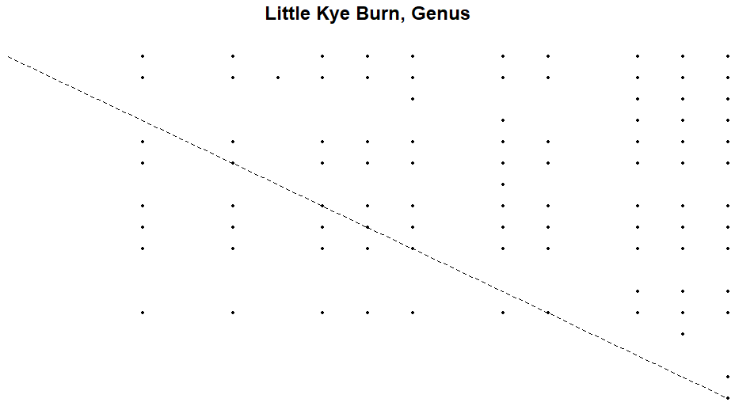
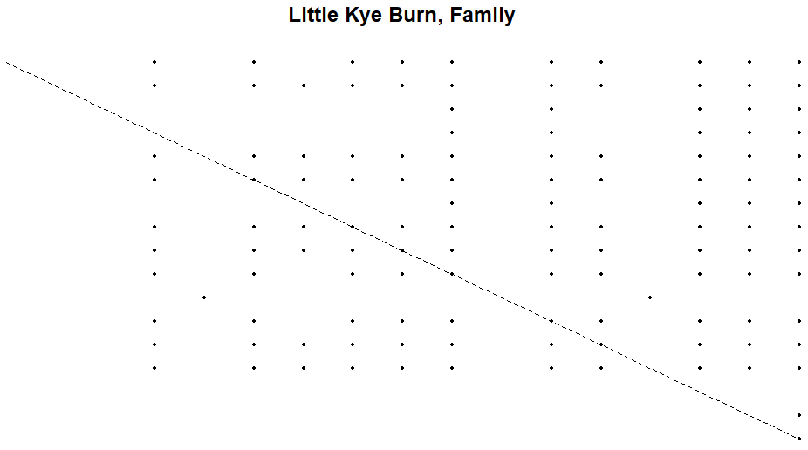
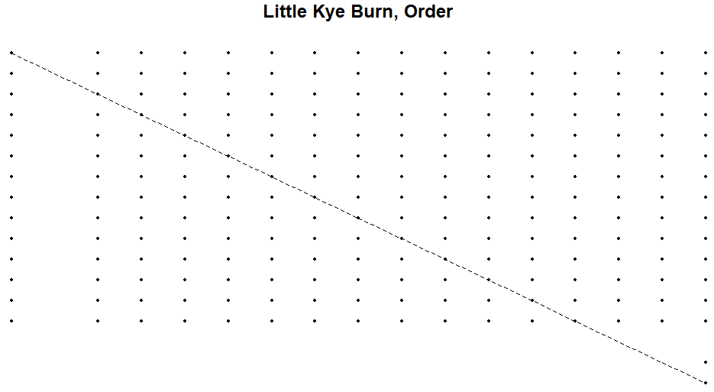
TSS = 0.704
TSS = 0. 589
TSS = 0.242

Slide 31
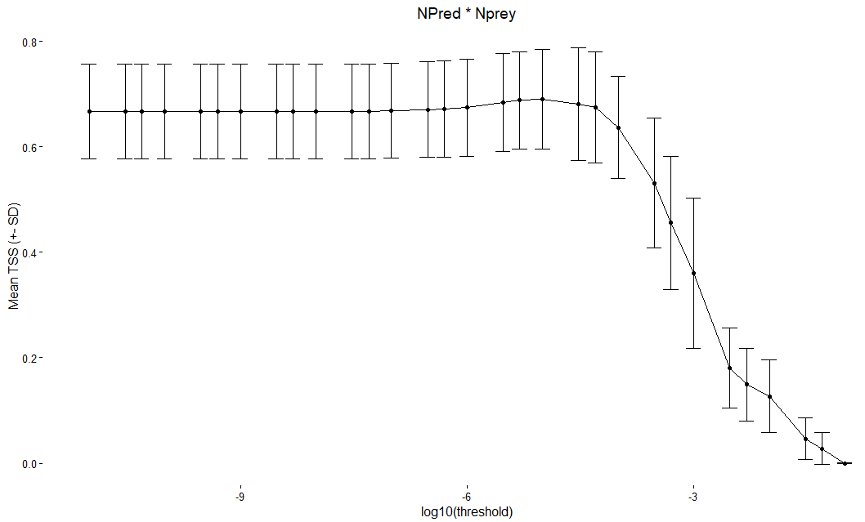
WebBuilder function, Neutral model
Neutral model correction for WebBuilder function did not improve model predictions. All further results are using initial inferred links of WebBuilder function
Supplemental figure (?)
Parameterization of relative abundance correction for Gravel model. Relative abundance calculated by multiplying relative abundance predator * relative abundance prey

Slide 32
Comparison of methods

Slide 33
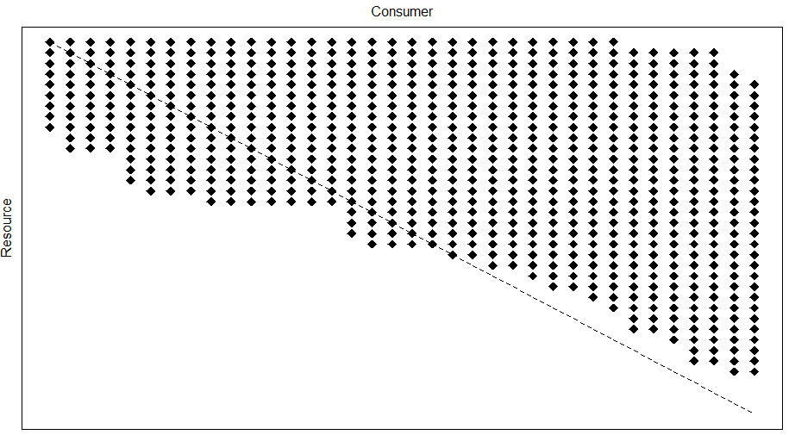
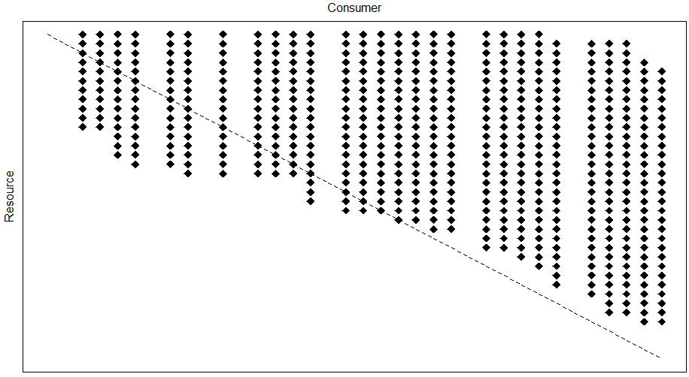
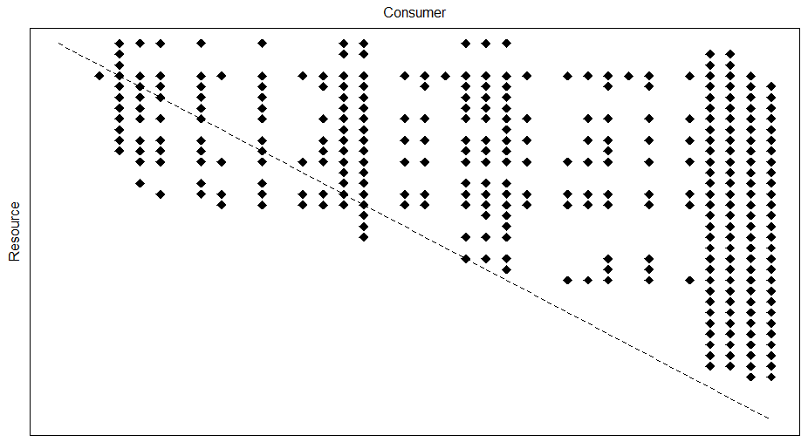
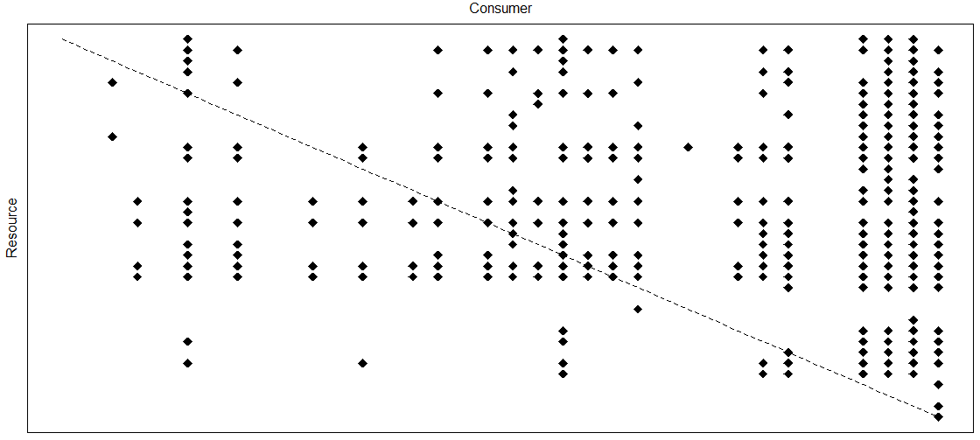
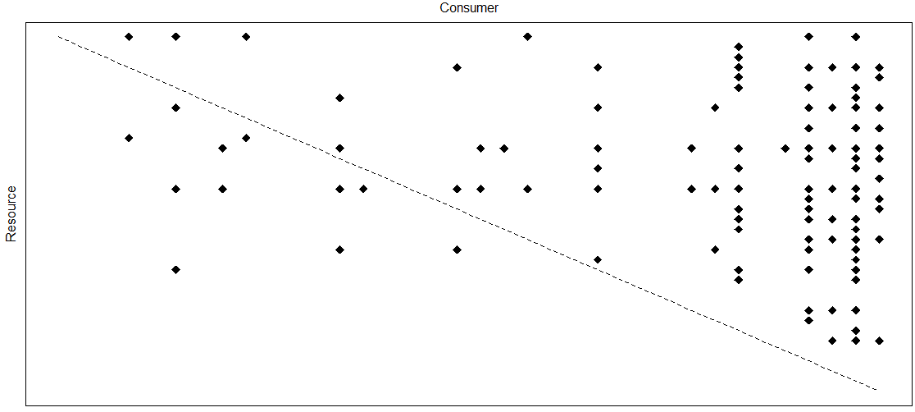
Dempsters Creek
Biomass inferred
Pruned
Relative abundance threshold
Gravel method, 3 steps
WebBuilder
Observed Network

Slide 34
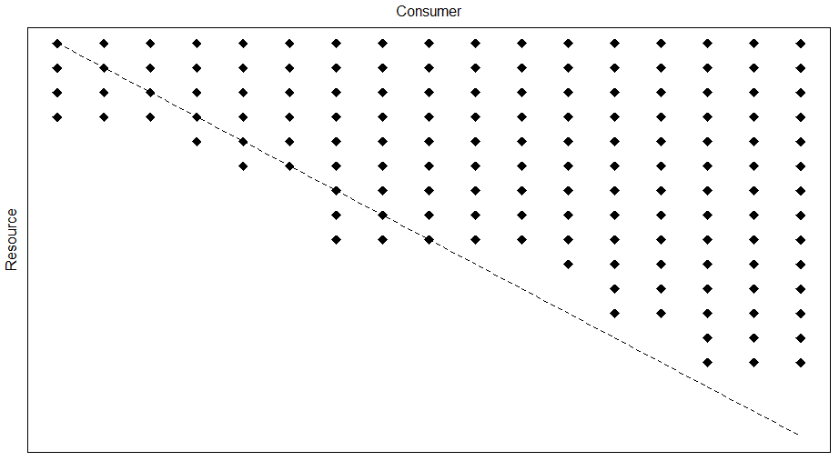
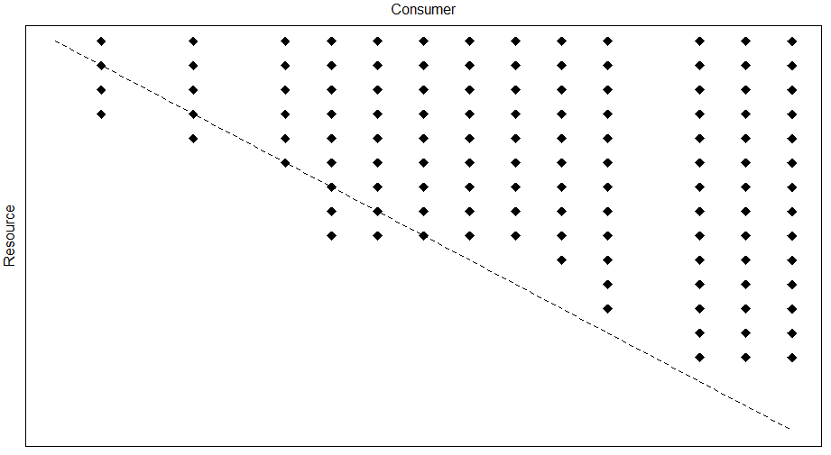
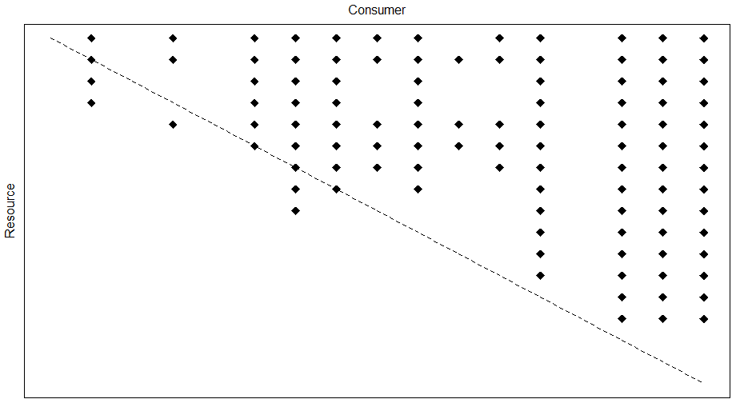
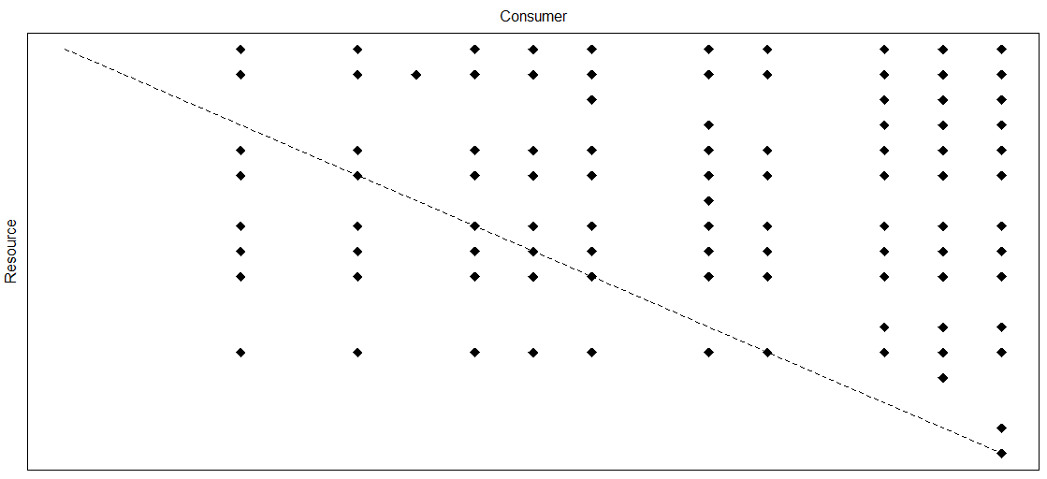
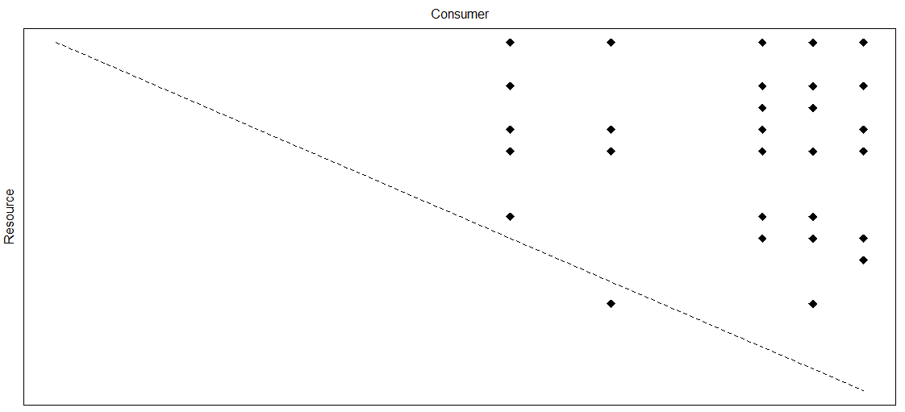
Little Kye Burn Creek
Biomass inferred
Pruned
Relative abundance threshold
Gravel method, 3 steps
WebBuilder
Observed Network

Slide 35
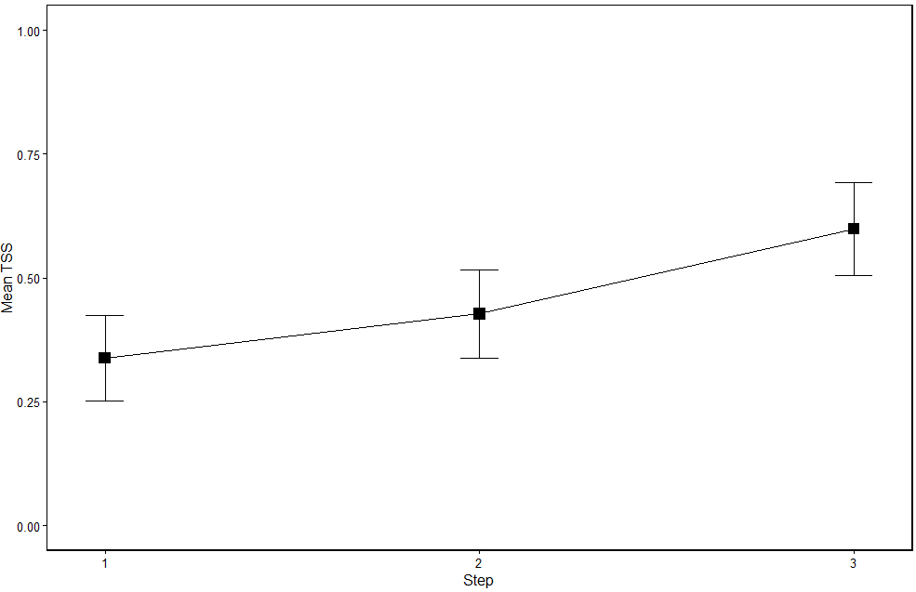
Trait-matching TSS Improves with additional steps
True Skill Statistic; TSS =
(a*d - b*c)/((a+c)*(b+d))
a = true positive; links both obserevd & predicted
b = false positive; predicted but not observed
c = false negative; observed but not predicted
d = true negative; not predicted, not observed
TSS = 1 = perfect prediction
TSS = -1 = inverse prediction
Step 1 = body mass fxn, step 2 = prune, step 3 = relative abundance

Slide 36
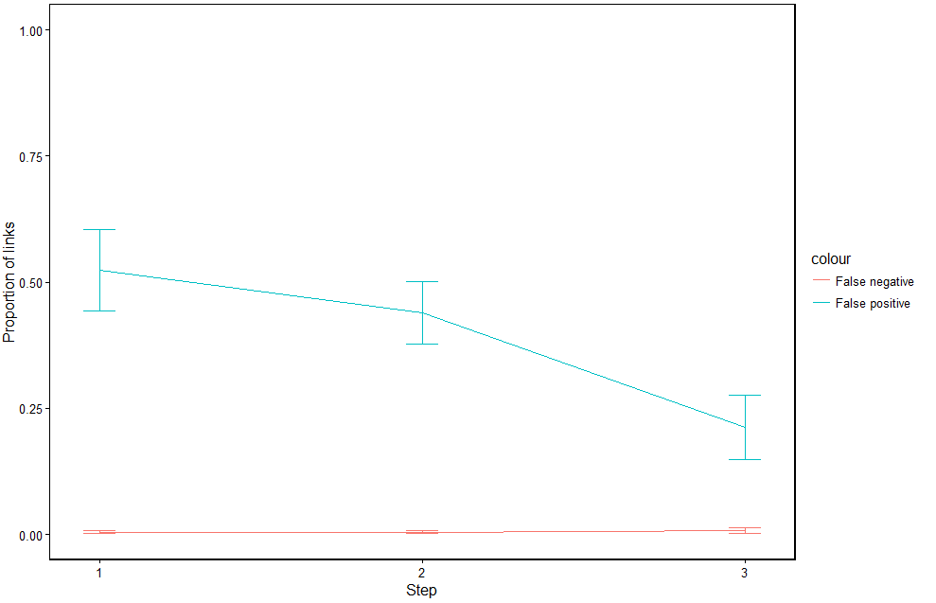
Trait-matching, changes in False Positive and False Negative rate with additional model steps

Slide 37
TSS of methods equivalent after additional steps
Model | True Positive (a) | True negative (d) | False positive (b) | False negative (c)
WebBuilder | 0.0403 | 0.7291 | 0.2246 | 0.0078
Gravel, step 3 | 0.0400 | 0.7400 | 0.2120 | 0.0080
Mean proportion of links for food webs inferred using the WebBuilder function, and the 3rd step in the modified gravel method

Slide 38
Conclusions of inferred food webs similar
Numerous metrics calculated for each web, including number of links (L), Links per species (L/S) connectance (C = L/S²), SD Generality (number of prey per consumer) and SD Vulnerability (number of consumers per prey).
Following graphs show food web statistics of observed webs (x-axis) and stats of modelled webs (y-axis).
Black line = 1:1

Slide 39
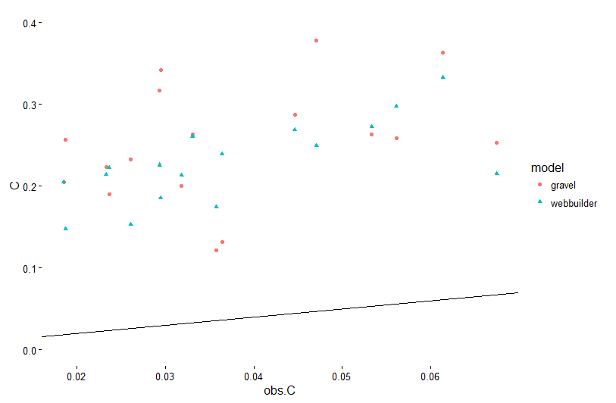
Connectance

Slide 40
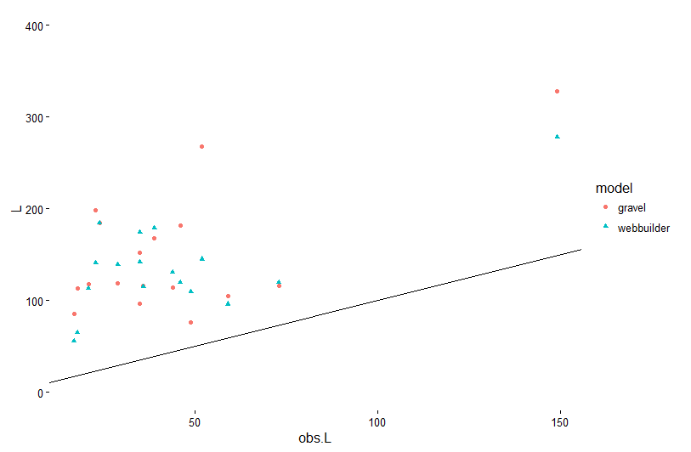
Links

Slide 41
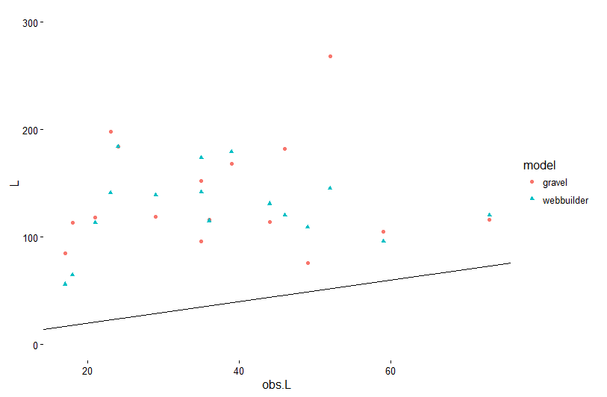
Links (removing potential outlier)

Slide 42
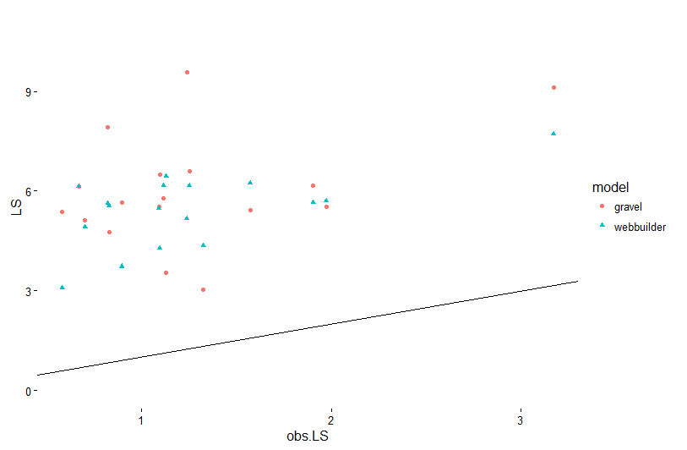
Links per Species

Slide 43
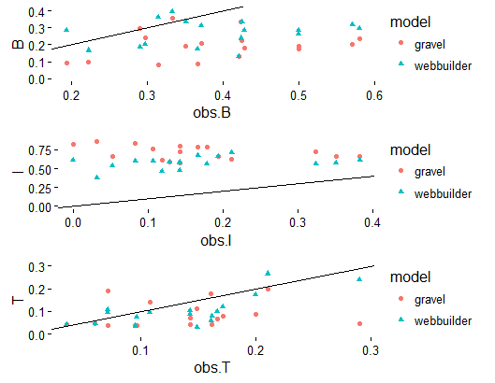
Basal, intermediate, and top species, respectively

Slide 44
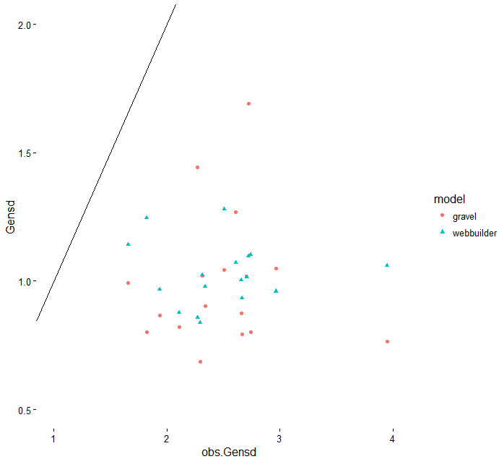
SD of generality (mean resources per node /(L/S))

Slide 45
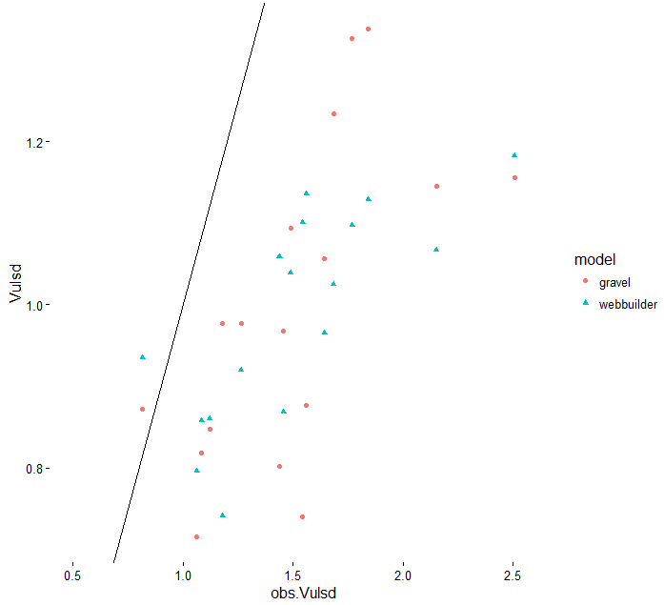
SD of vulnerability (mean consumers per node / (L/S))

Slide 46
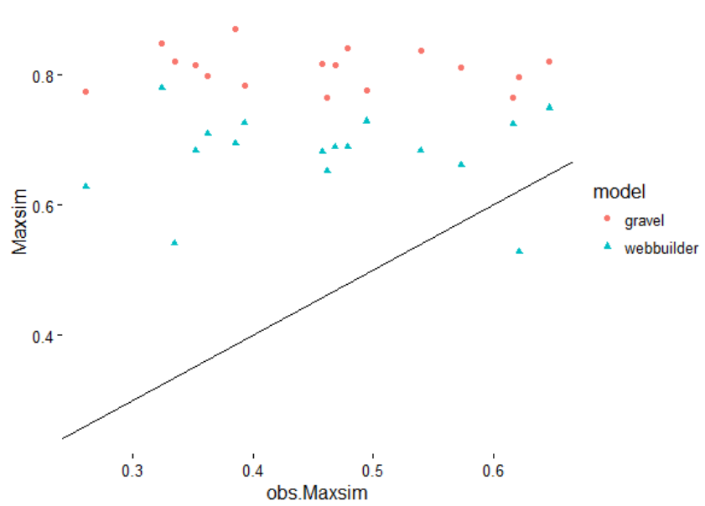
Max similarity (measure of diet overlap)

Slide 47
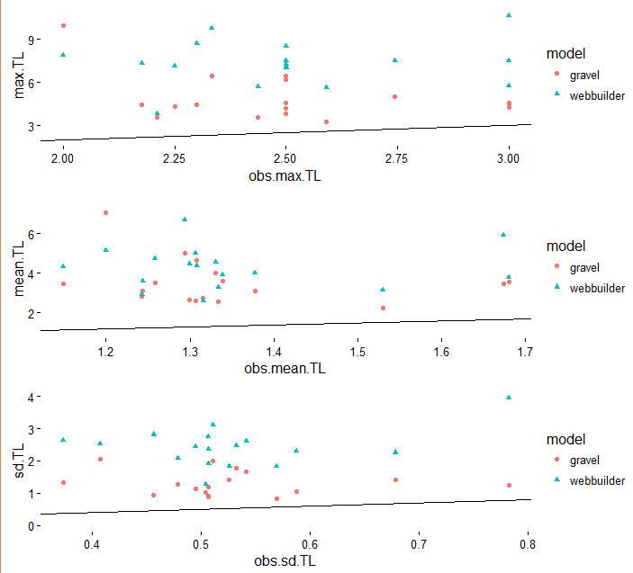
Max, mean, and SD of Trophic level

Slide 48
Table summarizing relationship of modelled metric compared to observed
Statistic | Trait matching | WebBuilder
C | + | +
L | + | +
LS | + | +
B | + | +
I | - | +
T | Weak + | +
genSD | NR | NR
vulSD | + | +
maxSim | NR | NR
Mean.TL | - | NR
Max.TL | - | +
SD.tl | - | +
Note that this is a qualitative assessment based on visual description of the slope of the lines.
I did not run linear regressions on these, I can, but not sure if this is necessary and might add a lot to the paper.
May be beneficial to run stats and just report which were statistically significant? E.g. table similar to one on right, but +’s and –’s could represent significance / non?

Slide 49
Statistical relationship of modelled v observed
Statistic | Trait matching | WebBuilder
C | NS | +
L | + | +
LS | NS | +
B | NS | NS
I | NS | NS
T | NS | +
genSD | NS | NS
vulSD | + | +
maxSim | NS | NS
Mean.TL | NS | NS
Max.TL | NS | NS
SD.tl | NS | NS
Significance of whether slope is ≠ 0

Slide 50
Dissimilarity measure
The dissimilarity of shared species interacting differently (β’_{OS} from Poisot et al. 2012) in the trait-matching inferred webs was similar to the observed webs. Note the scale of the X axis.
Vertical line in each plot is mean β’_{OS}
Interpretation of mean β’_{OS} :
β’_{OS} = 0 → perfect similarity, all species interact the same everywhere
β’_{OS} = 1 → complete dissimilarity, species interactions are completely site specific

Slide 51
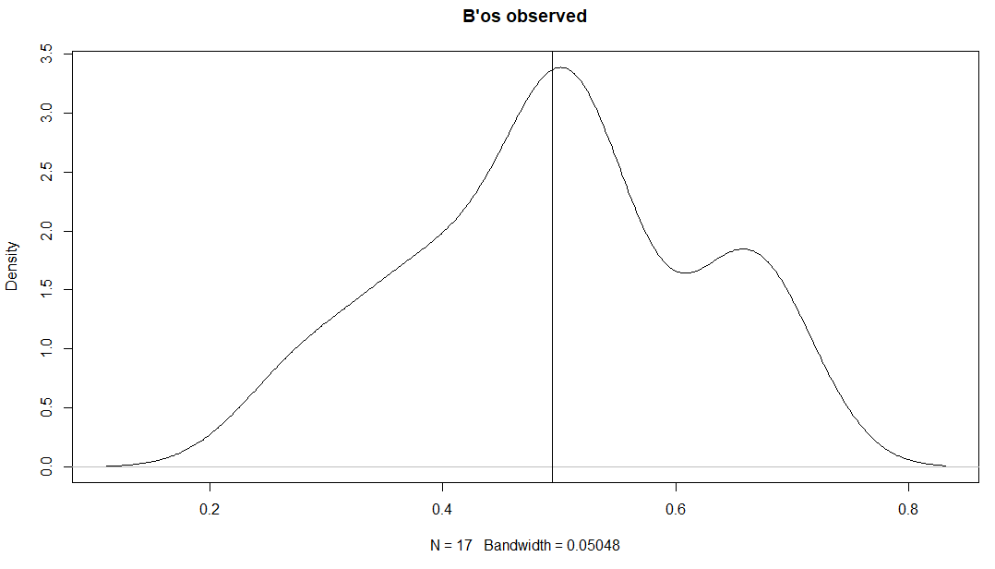
Mean = 0.49
Observed networks. Mean = 0.49. many species interact similarly regardless of location, however there is some local selection of species interactions

Slide 52
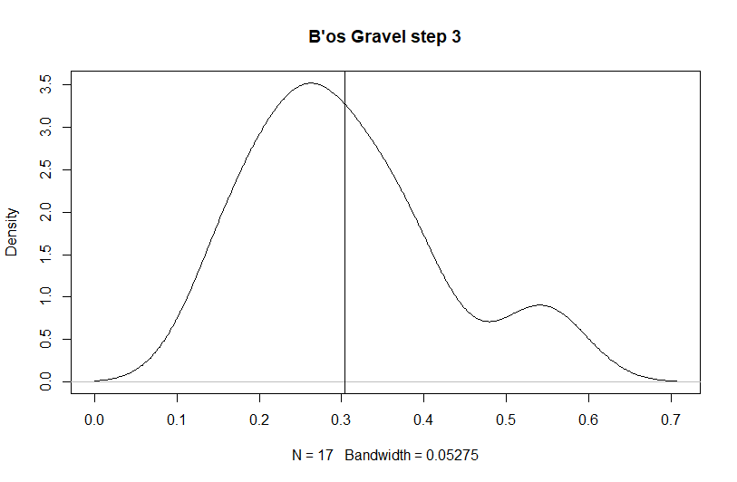
Mean = 0.30
Trait-matching method. Mean = 0.30. Most species interact similarly regardless of location. Less local selection of species interactions than empirical webs

Slide 53
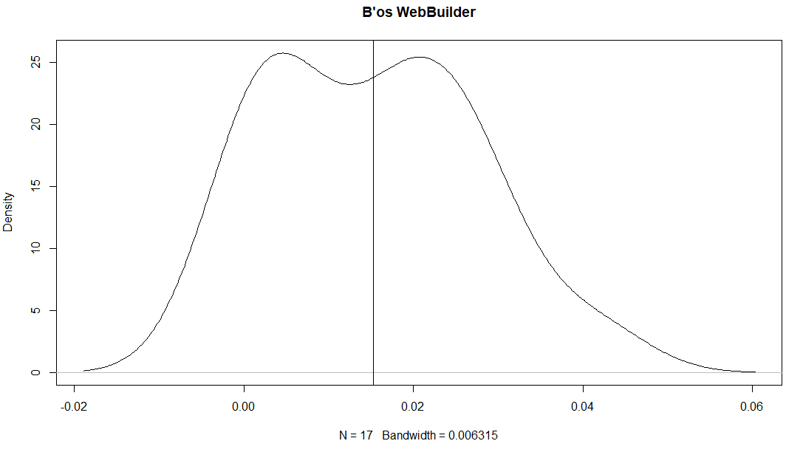
Mean = 0.015
WebBuilder function. Mean = 0.015. Essentially all species interact similarly regardless of location. As expected, since WebBuilder function does not allow for variation in species interactions by default.

Slide 54
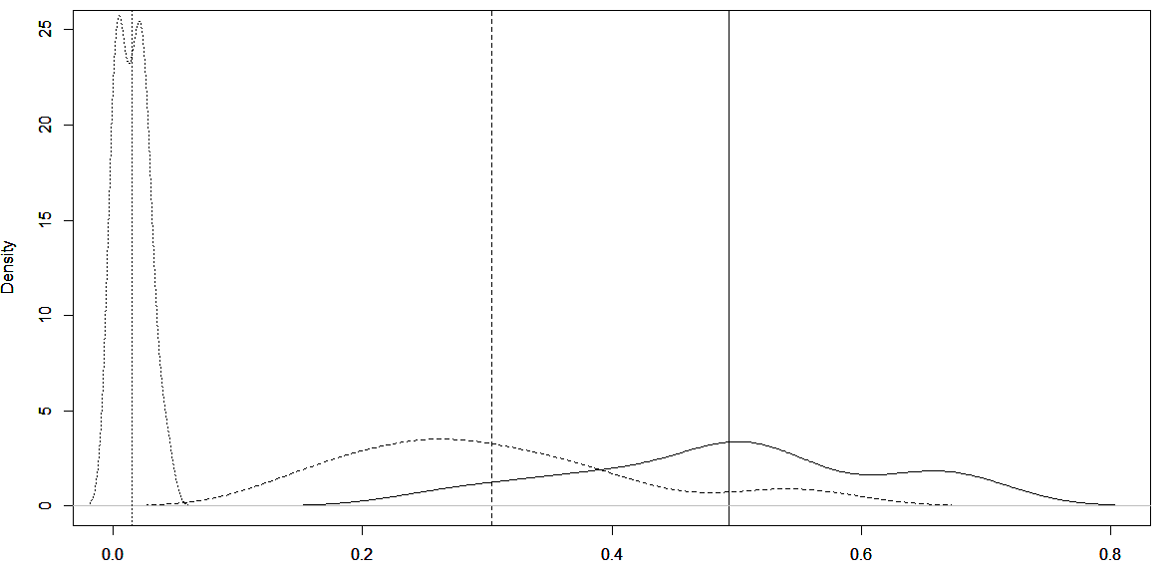
Density distributions, L to R: WebBuilder, Trait-matching, observed.
Vertical lines are means
(0.016, 0.29, 0.48, respectively)

Slide 55
Discussion
The WebBuilder function is simple, and requires a minimum amount of data input, e.g. just a list of taxa at a site. Could also include abundances, but including this information in the model did not improve predictions. As more feeding links are observed and added to the registry, however, accounting for relative abundances may prove to be more important.
Although WebBuilder is easy, it is insensitive to changes in food web structure without a concomitant large change in species composition. Therefore, using this method to look for changes in food web structure across sites, environmental gradients, etc, may be difficult.
However, this method may also provide complete meta-web of interactions at a site, so depending on research question, this may actually be beneficial.

Slide 56
Discussion
The trait-matching method, when combined with pruning and neutral model considerations, also provides a good approximation of food web structure. It requires much more data, but it allows for species interactions to vary at a given site, based on average species body mass, and relative abundances.
This model uses species averages, but could be improved with data on body sizes of individual predators and their preys.
Could be expanded by grouping species into different size classes (e.g. “small”, “medium”, “large” toe biter, instead of mean size). Could also estimate metaweb by making assumptions of changes in biomass distribution through time, or modelling growth rates, etc.

Slide 57
Recommendations
Both methods provide useful tools, depending on the research question at hand.
Many groups, organizations, researchers, etc, have large amounts of biomonitoring survey data across large spatiotemporal scales. WebBuilder allows for easy inference of the food webs at these sites, and may provide useful generalizations of food webs.
Including species average body sizes, or individual measurements does require additional logistical considerations in survey studies, but also allows for the greater inference of food web structure, and can provide useful information on other aspects, including link strength, growth rates, secondary production, etc (many sources, not citing them at this time).

